Slide 1
VII.3 SPM

Slide 2
When?
Incremental approach
Waterfall model
Agile Model
Prototyping model
Spiral model

Slide 3
Which project?
Case 1: The Incremental Model
This model is an example of an evolutionary life cycle model. It combines the linear nature of the Waterfall model and the iterative nature of the Prototyping model.
The Incremental model divided the development life cycle into multiple linear sequences, each of which produces an increment of the final software product.
In this model, the software product is developed in builds. A build is defined as a self- contained unit of the development activity. The entire development cycle is planned for a specific number of logical builds, each having a specific set of features.

Slide 4
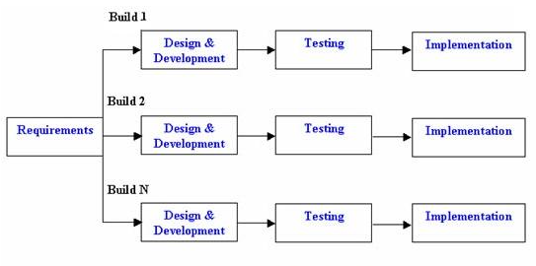
Incremental Model

Slide 5
Contd..
Case 2: Waterfall model
It gets its name from the way in which each phase cascades into the next.

Slide 6
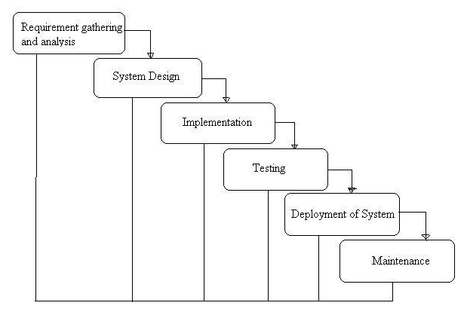
Waterfall Model

Slide 7
Contd..
Case 3: Agile model
Agile development model is also a type of Incremental model. Software is developed in incremental, rapid cycles. This results in small incremental releases with each release building on previous functionality.
Each release is thoroughly tested to ensure software quality is maintained.
It is used for time critical applications.

Slide 8
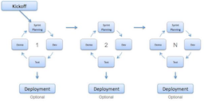
Agile Model

Slide 9
Contd..
Case 4: Rapid prototyping
It is particularly helpful in projects where the requirements are difficult to specify. The prototype can be used as a tool for analyzing and determining what the requirements should be.

Slide 10
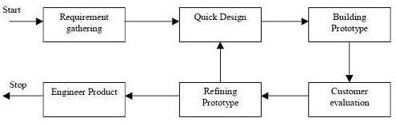
Prototyping Model

Slide 11
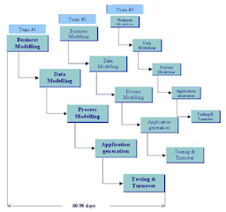
RAD Model

Slide 12
Contd..
Case 5: Another evolutionary life cycle model that combines the linear nature of the Waterfall model and the iterative nature of the Prototyping model. The project life cycle is divided into phases, and each phase is executed in all of the iteration of the Spiral Model.

Slide 13
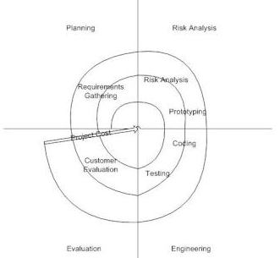
Spiral Model

Slide 14
Case study : SD Models
You are required to give real time applications of every model in terms when, Where, How it is used by giving advantages and disadvantages.
Incremental approach
Waterfall model
Agile Model
Prototyping model
Spiral model

